Slide 1
Fake News and its Detection
BY-
Aakash, Ahad, Kavya, Parul, Ritik, Sahil

Slide 2
Introduction
“Fake news has been around as long as human civilization, but it has been turbo-charged by digital technology and the transformation of the global media landscape.”

Slide 3
Types of Fake News
● Satire or parody
● False Connection
● Misleading Content
● False Context
● Imposter Content
● Manipulated Content
● Fabricated Content

Slide 4
B. Motivation
Economical reason
Political reasons
To gain fame
To defame the company

Slide 5



C. Different ways of spreading fake news
Major Role of Social Media

Slide 6
D. Harmful Impacts on Society and Health
Targeting women
Racist idea
Undermining democracy
Suppressing minors in the state
Amplifying division in society.

Slide 7
E. Examples of some past spread of fake news and the harm that it caused.
In 2013 Muzaffarnagar riots, which claimed over 60 lives and displaced thousands, were fueled by videos circulated on WhatsApp.
Following the murder of a two-and-a-half-year-old in Aligarh in 2019, misinformation related to the brutalities of the incident was viral on the social media.
Piyush Goyal, the Minister for Power in India, had tweeted a photo promoting a government street-lighting programme, but the photo was of a place in Russia

Slide 8
Some more past examples:-
Misinformation related to the coronavirus COVID-19 pandemic is in the form of social media messages related to home remedies that have not been verified, fake advisories and conspiracy theories.
The Supreme Court of India asked the central government of India to consider "a plea for publicizing aims, objectives and the benefits of the Citizenship Amendment Act (CAA) to weed out fake news that was being circulated on the issue." The plea lawyer stated "I visited Jamia and Seelampur yesterday. 95% protesters do not know about the CAA. They feel the law will take back their citizenship. Miscreants are circulating fake news"

Slide 9
Objectives
Objective 1: Ways for Detection of FAKE v/s FACT
Objective 2: Implementing different AI models to detect fake news
Objective 3 : Comparing different AI models and which one performs the best

Slide 10
Objective 1: Ways for Detection of FAKE v/s FACT
Develop a Critical Mindset
Check the source
Examine the Evidence
Check bias
Don’t Take Images at Face Value

Slide 11
Objective 2: Implementing different AI models to detect fake news
Random Forest
Multinomial Naive Bayes
GloVe Embedding

Slide 12
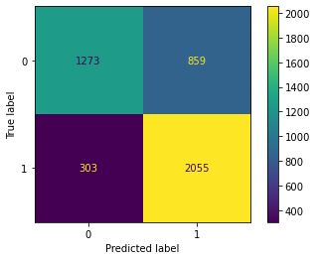
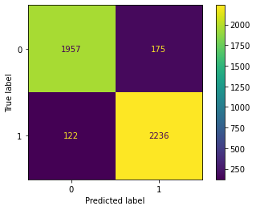
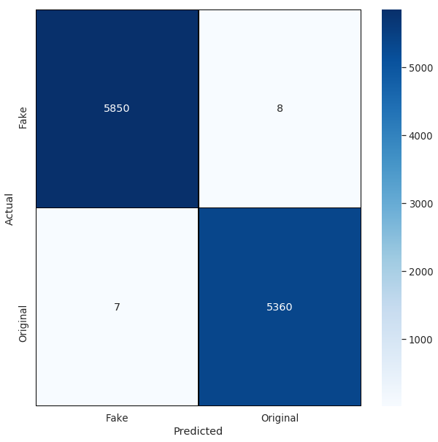
Objective 3 : Comparing different AI models and which one performs the best
Random Forest
Multinomial Naive Bayes
GloVe Embedding
Train accuracy : 93.7%
Test Accuracy : 91.8%
Train accuracy : 95.8%
Test accuracy : 94.4%
Train accuracy : 98.8%
Test Accuracy : 98.1%

Slide 13
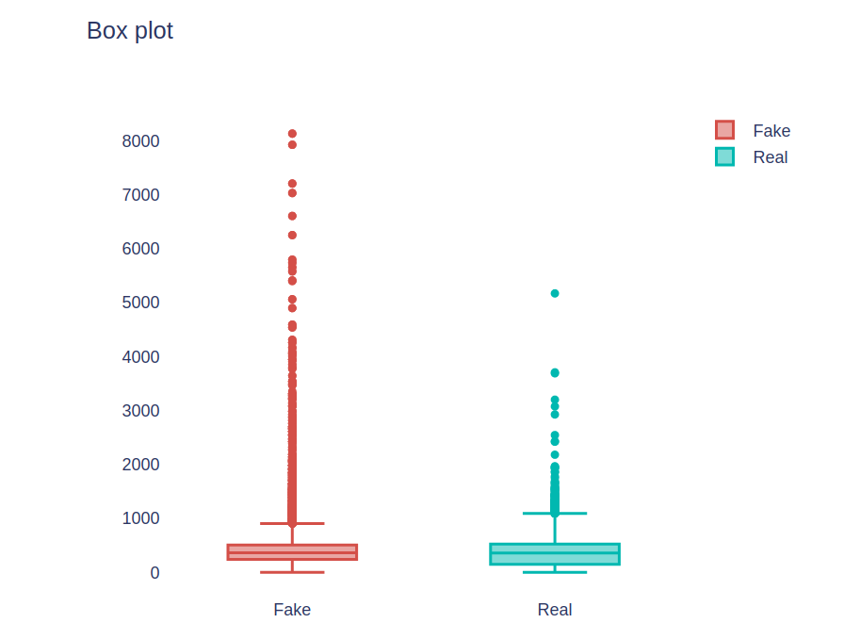
DATA ANALYSIS
From this Box plot we can analyze that :
Fake news has a lot more different tokens than the real ones, this was to be expected assuming that the fake news comprises of many tweets where people use abbreviations , slang word and language addictions in non-formal writing.
Figure : Box plot of tokens of words

Slide 14
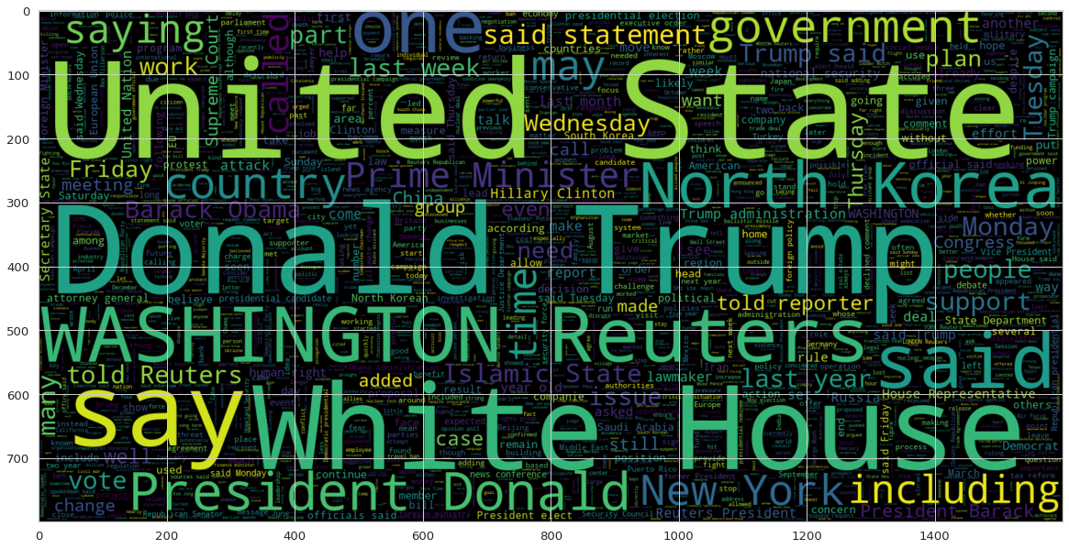
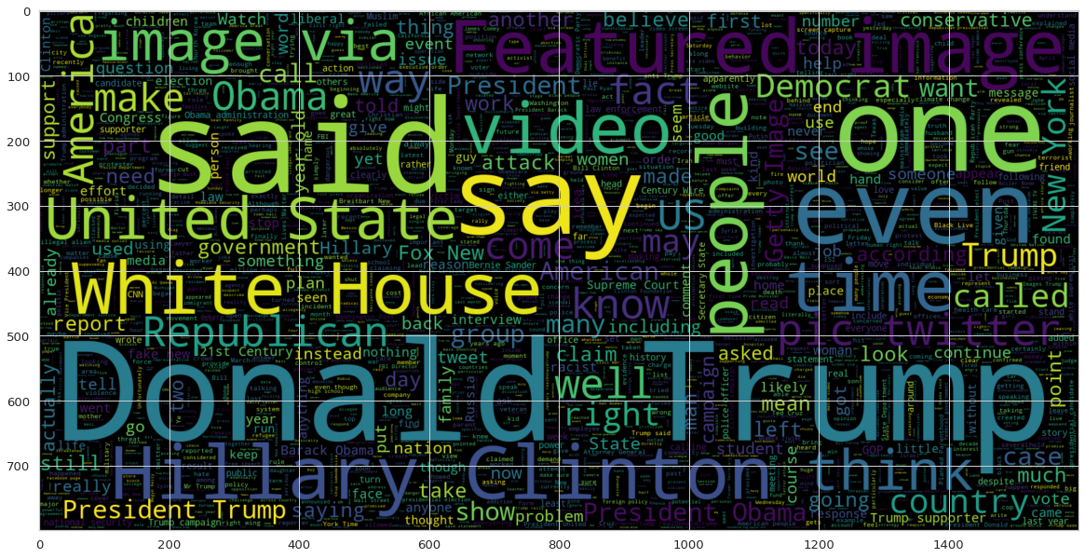
WORD CLOUDS
Word Cloud of True news
Word Cloud of fake news

